Slide 1
Project ON Fake News Detection using Machine Learning and Python

Slide 2
Introduction -
Fake news has been around for decades and is not a new concept. However, the dawn of the social media age has aggravated the generation and circulation of fake news many folds. Fake news can be simply explained as a piece of article which is usually written for economic, personal or political gains.
Many scientists believe that fake news issue may be addressed by means of machine learning and artificial intelligence . Detection of such unrealistic news articles is possible by using various NLP techniques, Machine learning, and Artificial intelligence.

Slide 3
Requirement :-
Dataset
HTML for Flask App
Sklearn
Pandas
Jupyter Notebook

Slide 4
Train / Test -
Train/Test is a method to measure the accuracy of your model.
It is called Train/Test because you split the the data set into two sets: a training set and a testing set.
80% for training, and 20% for testing.
You train the model using the training set.
You test the model using the testing set.
Train the model means create the model.
Test the model means test the accuracy of the model.

Slide 5
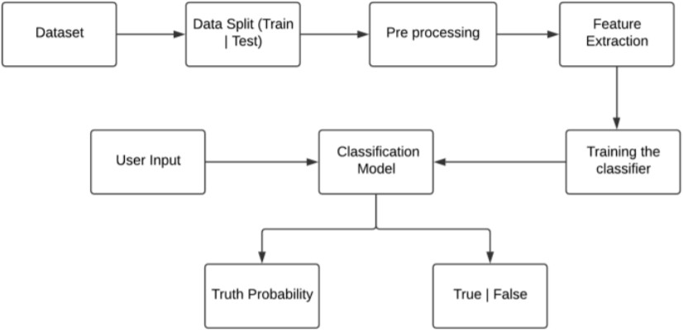

Slide 6
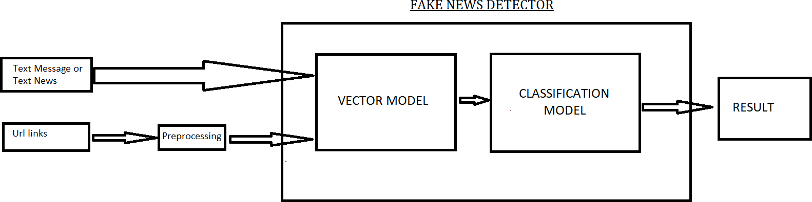

Slide 7
TfidfVectorizer & Logistic Regression
TF (Term Frequency): The number of times a word appears in a document is its Term Frequency. A higher value means a term appears more often than others, and so, the document is a good match when the term is part of the search terms.
IDF (Inverse Document Frequency): Words that occur many times a document, but also occur many times in many others, may be irrelevant. IDF is a measure of how significant a term is in the entire corpus.The TfidfVectorizer converts a collection of raw documents into a matrix of TF-IDF features.
The logistic function, also called the sigmoid function was developed by statisticians to describe properties of population growth in ecology, rising quickly and maxing out at the carrying capacity of the environment. It’s an S-shaped curve that can take any real-valued number and map it into a value between 0 and 1, but never exactly at those limits.

Slide 8
Decision Tree Classification &Gradient Boosting Classifier
Decision Tree is a Supervised learning technique that can be used for both classification and Regression problems, but mostly it is preferred for solving Classification problems. It is a tree-structured classifier, where internal nodes represent the features of a dataset, branches represent the decision rules and each leaf node represents the outcome.
Gradient Boosting is a popular boosting algorithm. In gradient boosting, each predictor corrects its predecessor’s error. In contrast to Adaboost, the weights of the training instances are not tweaked, instead, each predictor is trained using the residual errors of predecessor as labels

Slide 9
Random Forest Classifier
Random Forest is a trademark term for an ensemble of decision trees. In Random Forest, we’ve collection of decision trees (so known as “Forest”). To classify a new object based on attributes, each tree gives a classification and we say the tree “votes” for that class. The forest chooses the classification having the most votes (over all the trees in the forest). The random forest is a classification algorithm consisting of many decisions trees. It uses bagging and feature randomness when building each individual tree to try to create an uncorrelated forest of trees whose prediction by committee is more accurate than that of any individual tree. Random forest, like its name implies, consists of a large number of individual decision trees that operate as an ensemble. Each individual tree in the random forest spits out a class prediction and the class with the most votes becomes our model’s prediction. The reason that the random forest model works so well is: A large number of relatively uncorrelated models (trees) operating as a committee will outperform any of the individual constituent models.

Slide 10
Thank You

